Slide 1


Quantification of Trabeculae Inside the Heart From MRI Using Fractal Analysis

Slide 2
SUPERVISOR
Medical Sensor Project Defense 2O18
Semester 1, MAIA, M-1
Dr. Alain LALANDE
Group Members
Md. Kamrul Hasan MAIA, M-1
Fakrul Islam Tushar MAIA, M-1

Slide 3
Contents of The Presentation
What is Heart
Objective of the Project
Fractal Analysis
Snake model
Project Outcomes
Quantifications of Trabeculae
Manual Segmentations
Semi-automatic Segmentations
Conclusion and Future Improvement
Reference

Slide 4
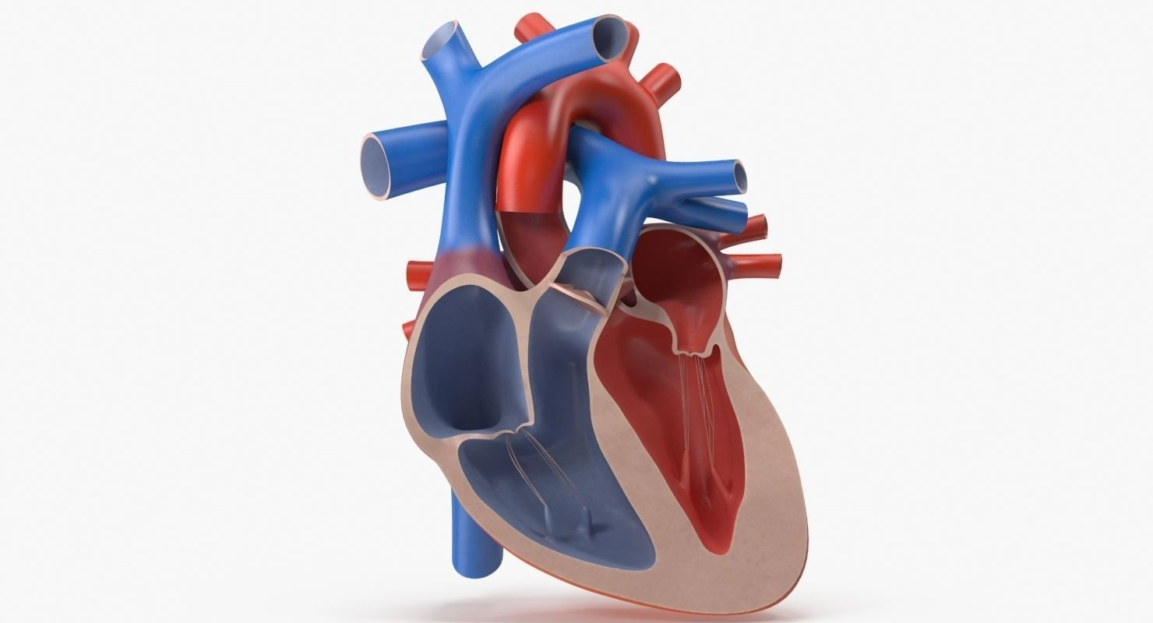
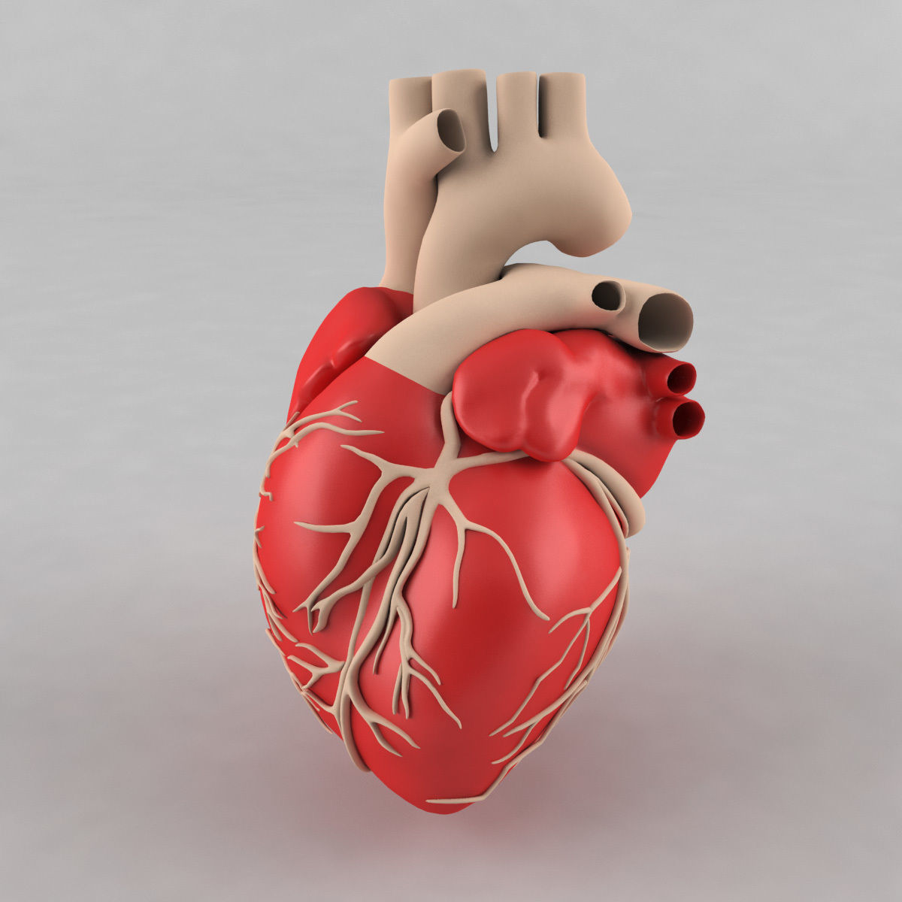
What is heart and why it’s so Important ??
Heart weighs less than a pound
Responsible for system of Blood Vessel
Beats 2.5 billion times over a average life time
Fig.1: Image of heart [1]

Slide 5
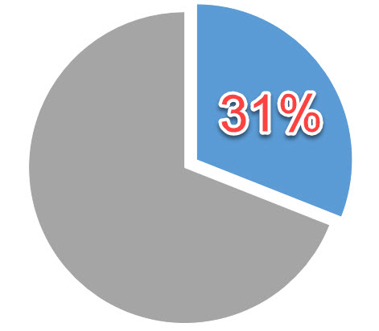
Cardiovascular Diseases (CVDs)
According to World Health Organization (WHO) in 2015
17.7 million people died from from various CVDs
31% of all world’s Deaths

Slide 6
Objective of the Project
Quantification of Trabeculation Due to Left Ventricular Non-compaction (LVNC).
1
2
3
Get Target MRI
Quantification
Detection of trabeculation

Slide 7
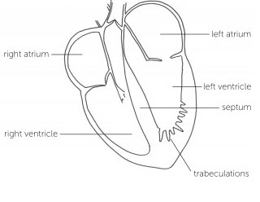
What is Left Ventricle Non-Compaction??
LVNC is a condition of heart
Where the wall of the left ventricle are non-compacted
This causes channel to form in heart muscle, called trabeculations.
Fig.2: The structure of heart with LVNC [2] .

Slide 8
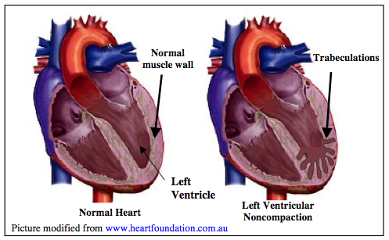
How Trabeculations form ??
Fig.2: Normal heart vs LVNC heart structure [3] .

Slide 9
What is Fractal Dimension ??
Quantify the complex geometric patters of biological and natural patterns.
Fractal Dimension ( FD)
Complexity of the structure
FD of Endocardium border is an Non-integer between 1 and 2.
1<FD< 2

Slide 10
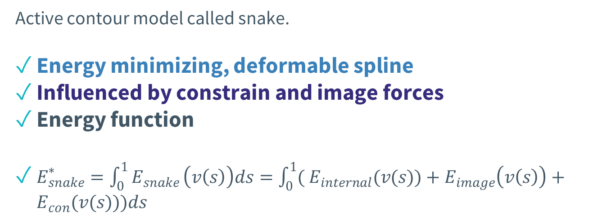
What is Snake Algorithm??
Active contour model called snake.
Energy minimizing, deformable spline
Influenced by constrain and image forces
Energy function
$E_{snake}^{∗}=\int_{0}^{1}{E_{snake}}\left(v\left(s\right)\right)ds=\int_{0}^{1}{( E_{internal}(v(s))}+E_{image}\left(v\left(s\right)\right)+E_{con}(v(s)))ds$

Slide 11
Project Outcomes

Slide 12
Quantifications of Trabeculae

Slide 13

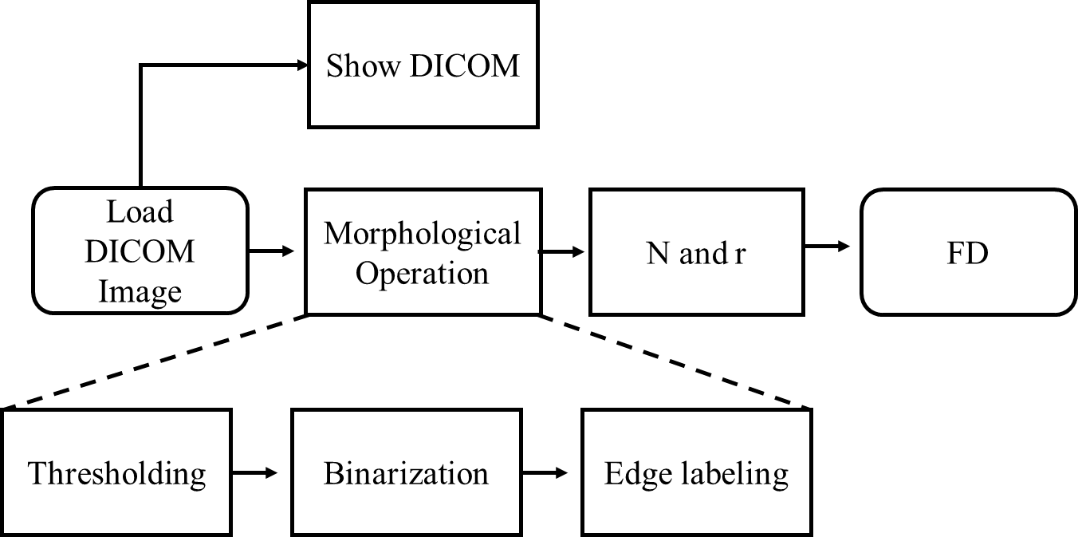
Complexity Analysis Block Diagram
Complexity Analysis Block Diagram.

Slide 14
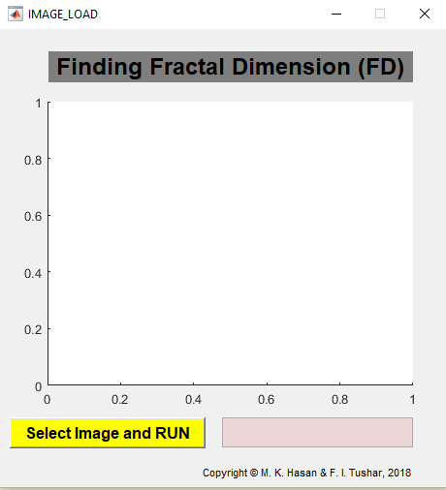
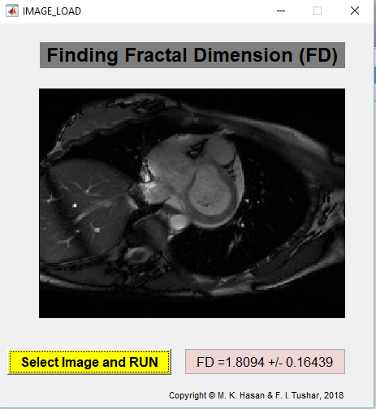
Implementations in GUI

Slide 15
Manual Segmentations

Slide 16
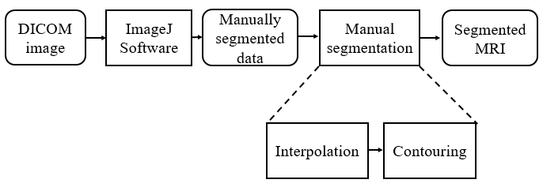
Manual Segmentation of Heart MRI/ CMRI
Block diagram for manual Segmentation.

Slide 17
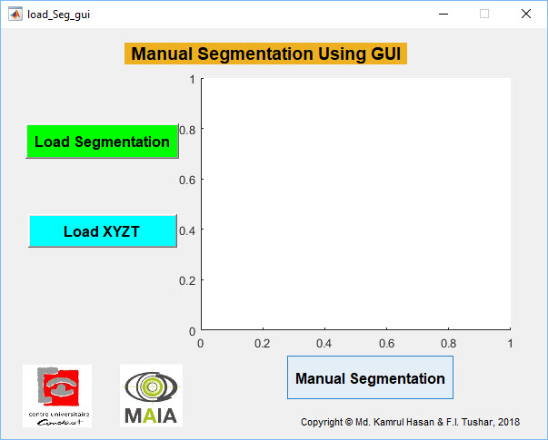
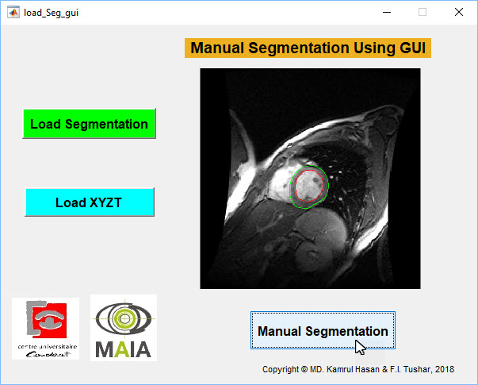
Implementations in GUI

Slide 18
Semi-automatic Segmentations

Slide 19
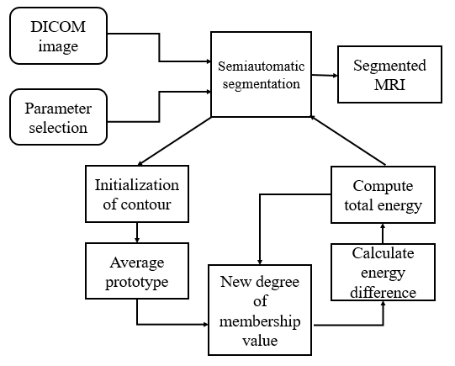
Semi-automatic Segmentation of Heart MRI/ CMRI

Slide 20
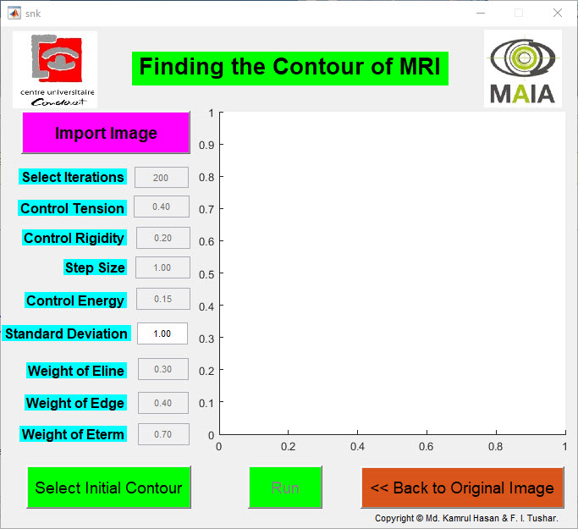
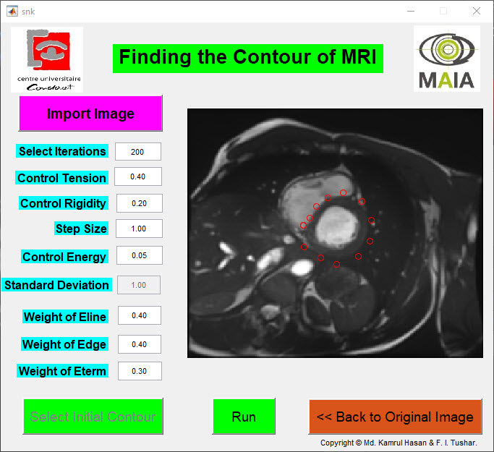
Implementations in GUI

Slide 21
Conclusions
Due to the trabeculae, the geometric pattern of the inner part of the heart become more complex.
2. Semi-automatic segmentation is more reliable and easily
implementable for heart MRI/ CMRI segmentations.

Slide 22
Future Improvement
Some segmentation algorithm like Watershed-Matching Algorithm can be implemented in Python in conjunction with OpenCV for better results.

Slide 23
References
Anatomyshop,“Heart Cutaway | 3D model,” CGTrader. [Online]. Available: https://www.cgtrader.com/3d-models/character/anatomy/heart-cutaway. [Accessed: 17-Jan-2018].
Left ventricular non-compaction cardiomyopathy - Cardiomyopathy UK. [Online].Available: http://www.cardiomyopathy.org/left-ventricular noncompaction/intro. [Accessed: 17-Jan-2018].
Cardiomyopathy,” Left Ventricular Non-Compaction Cardiomyopathy (LVNC). [Online]. Available: https://www.cincinnatichildrens.org/service/c/cardiomyopathy/types/left-ventricular-non-compaction-cardiomyopathy. [Accessed:17-Jan-2018].

Slide 24
Thank you !!!☺

